Slide 1
Basics for Building on Our Life Sciences Strengths
www.biocrossroads.com

Slide 2
“Though every state wants to be a hub for life sciences, Indiana really is one... Life sciences accounted for 23% of all [Indiana] job growth from 2001 to 2007.”
The Economist, June 4, 2009

Slide 3
“This intense concentration is the magic elixir of modern economies… why San Diego and Indianapolis are global players in life sciences…”
Time Magazine Nov. 1, 2010

Slide 4
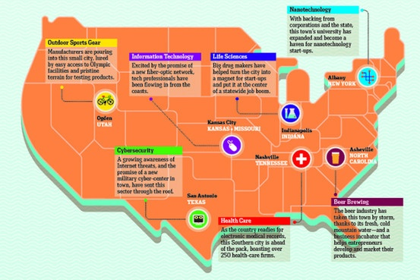
“Where the Action Is”, The Wall Street Journal
front page of The Journal Report, Aug. 22, 2011

Slide 5
Indiana’s Strengths:
We start with an enviable number of leading life science and biotech companies. These companies put thousands of Hoosiers to work every day in great, highly skilled and high-paying jobs.

Slide 6
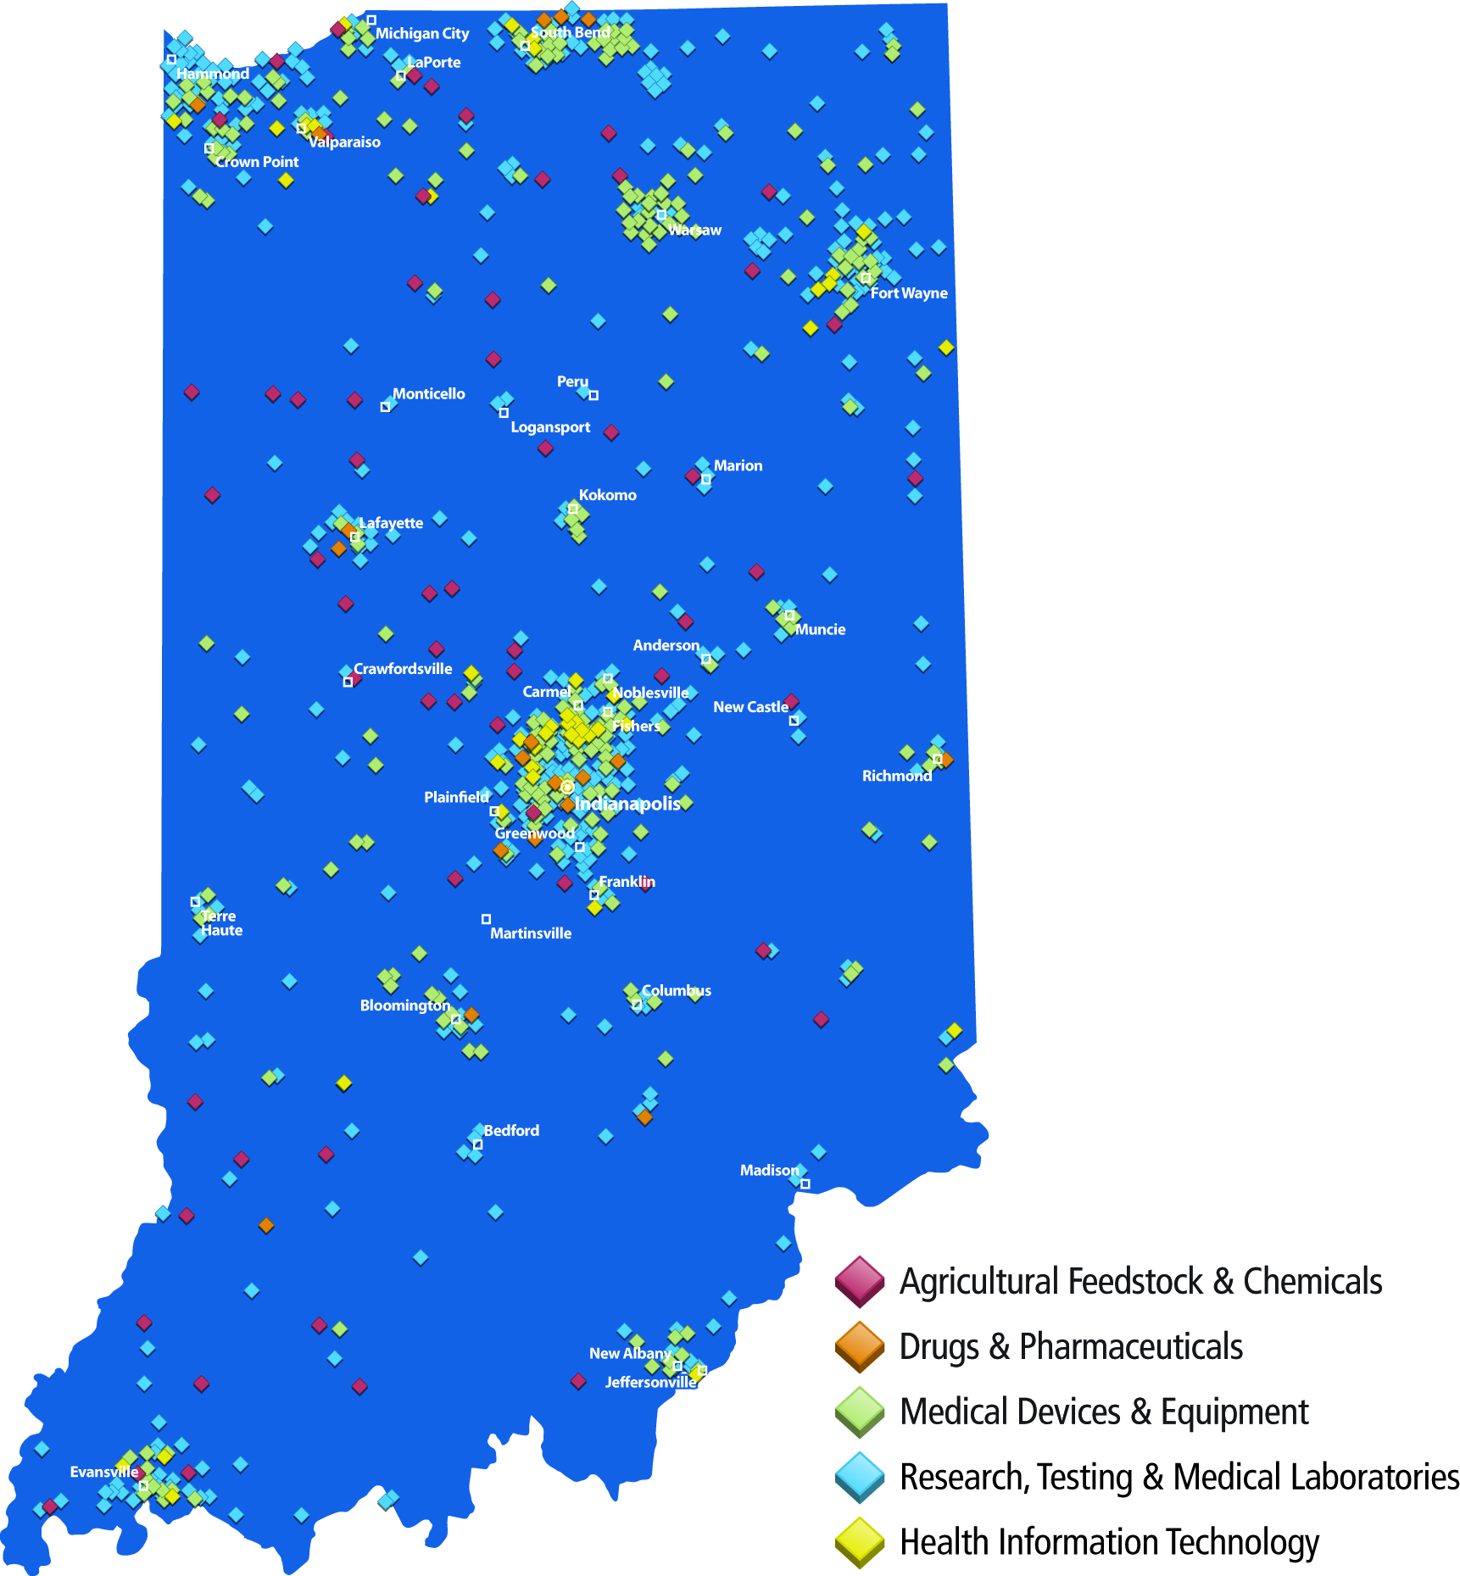
Indiana’s life sciences leaders
Warsaw
Zimmer (2,800)
DePuy (1,200)
Biomet (1,350)
Lafayette
Evonik (700)
Purdue University
Purdue Research Park
Indianapolis
Beckman Coulter (600)
Covance (1,800)
Dow AgroSciences (1,200)
Elanco (475)
Eli Lilly and Company (10,500)
Express Scripts (500)
PharmaNet/i3 (350)
Roche Diagnostics (3,000)
WellPoint (4,200)
Terre Haute
Eli Lilly and Company (200)
Rose-Hulman Institute of Technology
Bloomington
Indiana University
Baxter Biopharma Solutions (1,000)
Cook Group (4,500)
Seymour/Spencer/
Batesville
Boston Scientific (1,200)
Cook Urology (525)
Hill-Rom (2,000)
UCB Group (360)
Evansville
Bristol Myers Squibb (300)
Covance (200)
Mead Johnson (2,000)

Slide 7
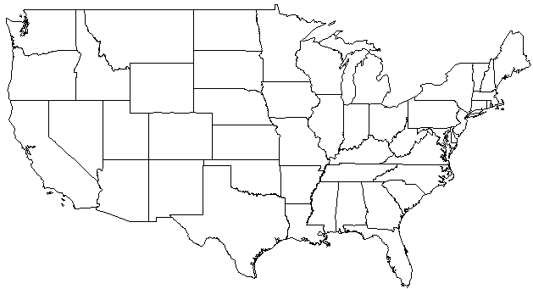
33% of the global orthopedics industry is based in Warsaw, Indiana
Minnesota - $3.4B
Illinois - $12M
Indiana - $16.7B
Michigan - $5B
Massachusetts - $299M
New York - $414M
Oregon - $95M
Pennsylvania
$2.9B
New Jersey
$453M
Colorado - $7M
Maryland
$15M
California - $815M
Virginia - $77M
North Carolina
$24M
Texas - $763M
Georgia - $4M
Florida - $642M
Rest of World
$4.9B
Tennessee - $389M

Slide 8
BIO/Battelle (2012) reports that Indiana is one of five states rated as Tier 1 – others are California, New Jersey, North Carolina and Massachusetts – for largest number of employees and companies

Slide 9
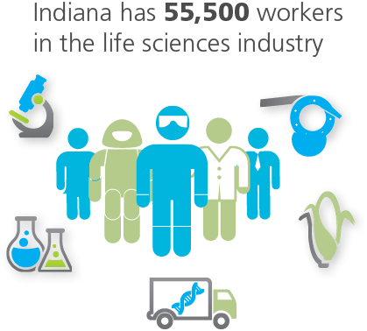
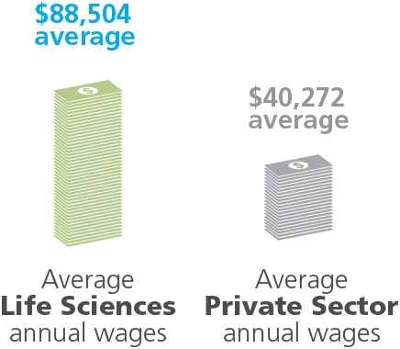
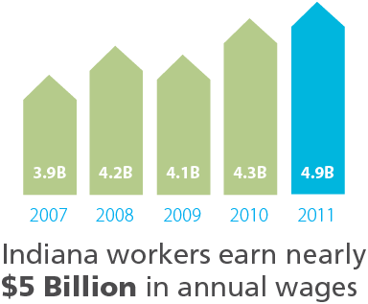
2011 data highlights the strength of Indiana’s life sciences sector and its impact on the State’s economy

Slide 10
Indiana’s Life Sciences Industry Includes All Major Segments
Medical Devices and Equipment: 32%
Drugs and Pharmaceuticals: 29%
Biologistics: 18%
Research, Testing and Medical Labs: 13%
Agricultural Feedstock and Chemicals: 8%
Over 55,000 Workers
Source: Indiana Business Research Center (IBRC) using data from the Bureau of Labor Statistics

Slide 11
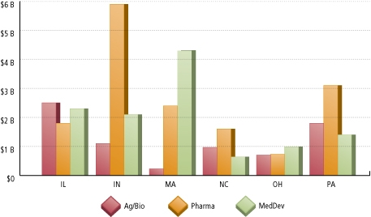
Indiana stands among the top three life sciences exporters in the U.S. – behind only California and Texas; exports nearly quadrupled between 2002 and 2011 to $9.3 billion

Slide 12
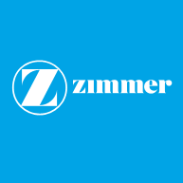
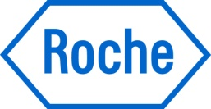
Indiana’s life science sector is growing – which reinforces its ability to attract scientific talent to the state.
R&D expansion (2005) - $24M
Mfg & distribution (2007) - $66M
Mfg (2008) - $19M
Warsaw
Mfg (2006) - $21M
R&D (2010) - $28M
Warsaw
Centrifuge mfg (2007) - $6M
Business Ops (2009) - $11M
Mfg (2010) - $18M
Indianapolis
World’s largest automated
pharmacy (2007) - $165M
Whitestown
R&D expansion (2010) - $343M
Indianapolis
Mfg (2011) - $15M
Columbia City
HQ Expansion (2012) - $14M
Greenfield
HQ Expansion (2012) - $300M
Indianapolis

Slide 13
Over 40 companies employ nearly 10,000 workers in biopharmaceutical development and manufacturing in Indiana – with a number of CROs and CMOs supplementing Indiana’s vertically integrated companies

Slide 14
Contract drug development providers are expanding in Indiana
Selected Expansions (2005-2012)
Contract biotech mfg (2005) - $70M*
Parenteral Fill/Finish (2008) - $80M*
Bloomington
Contract formulation (2005) - $34M
Bloomington
OTC Mfg (2007) - $60M
Portage
Preclinical development (2008) - $126M
Labs / Data Center (2012) - $150M
Greenfield
Solid dose mfg (2008) - $12M
Solid dose mfg (2011) - $34M
Seymour
Sample logistics (2009) - $6M
Indianapolis
Contract Mfg (2010)
West Lafayette
Preclinical development (2011) - $6M
Indianapolis
Contract Mfg (2012) - $85M
Terre Haute
*Detailed facility description available at www.pharmaceutical-technology.com/projects

Slide 15
What is BioCrossroads?
BioCrossroads is Indiana’s initiative to build on our
life sciences strengths
WE INVEST:
By launching and investing in new life sciences enterprises
WE CONNECT:
By partnering with Indiana’s life sciences research institutions, corporations, philanthropic organizations and state government to build new opportunities
WE EDUCATE:
By expanding science and math education in grades K-12 and higher learning institutions
WE SPREAD THE WORD:
By marketing Indiana’s life sciences industry

Slide 16
How BioCrossroads Works
WE INVEST by organizing and fundraising to build our own venture capital funds to provide money for new companies:
Indiana Future Fund – a $73 million venture capital fund-of-funds (managed by Credit Suisse, with 10 Indiana institutional investors) for early-stage life sciences investments; this fund started things off in 2003
Indiana Seed Fund I – a $6 million “pre-venture” fund (managed by BioCrossroads) organized in 2005
INext Fund – a $58 million venture capital fund-of-funds (managed by Credit Suisse, with 6 Indiana institutional investors) raised as a follow-on fund to the Indiana Future Fund in 2009
Indiana Seed Fund II – an $8 million “pre-venture” fund (managed by BioCrossroads) organized in April 2012

Slide 17
Beyond our investments, BioCrossroads has now supported more than 300 start-up companies and collaborations
We help these enterprises by –
Connecting them with industry partners
Providing basic business planning guidance
Advising on patent and IP strategies
Opening connections to sources for further commercial development
Linking with additional funding sources

Slide 18
How BioCrossroads Works
WE CONNECT by creating and branding new and financially self-sustaining life sciences enterprises:
IHIE – Indiana Health Information Exchange, Inc., a non-profit corporation advancing a national, revenue-based model for the secure sharing of clinical information among healthcare patients, providers and other healthcare entities. Known as the largest and most advanced health information exchange in the U.S.
Fairbanks Institute for Healthy Communities – a non-profit enterprise utilizing Indiana’s vast clinical resources to gather comprehensive patient clinical and biological information for the prediction, prevention and treatment of disease.
BioCrossroadsLINX – a related non-profit organization specifically focused on advancing Indiana's strengths in drug development and manufacturing.

Slide 19
How BioCrossroads Works
WE CONNECT by creating and branding new and financially self-sustaining life sciences enterprises:
Datalys Center for Sports Injury Research & Prevention – a national non-profit providing research and surveillance services to sports and health organizations.
OrthoWorx – a Warsaw-based, industry, community and educational non-profit initiative to advance and support growth and innovation within northern Indiana's uniquely concentrated, globally significant orthopedics device sector.
ExibHIT Indiana (Expanding Indiana’s Breakthroughs in Health Information Technology) – a branding initiative focused on advancing the development and effective use of HIT within Indiana and across the U.S. To date, and with BioCrossroads’ direct facilitation, Indiana and Indiana-based organizations have received over $50 million in federal ARRA funds to advance Indiana HIT.

Slide 20
How BioCrossroads Works
WE EDUCATE through responding to the industry’s human capital needs:
Talent Recruitment and Retention:
To connect young professionals 21-40 years old in the Indianapolis area and facilitate community engagement, BioCrossroads formed IndyHub in 2005
Training and Workforce Development:
To respond to training needs -- e.g. developing the Biotech Associate’s degree and market-demanded, specialized orthopedics training programs at Ivy Tech; Post-Baccalaureate Education report (Nov. 2012)
Improving K-12 Science and Math Education:
To provide the skilled workforce for STEM businesses, in 2006 BioCrossroads formed the I-STEM Resource Network

Slide 21
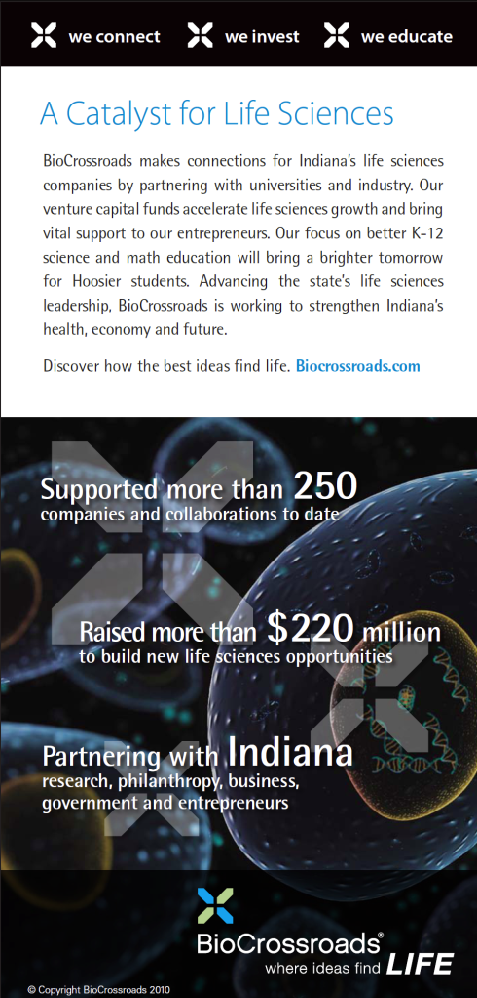
How BioCrossroads Works
WE SPREAD THE WORD by building awareness and marketing Indiana’s life sciences industry
BioCrossroads provides the public profile for the life sciences as a leading economic sector in the state of Indiana.
Representatives are quoted frequently in local and national publications and serve as speakers at regional and national life sciences conferences
BioCrossroads.com gets more than 230 hits per day and visitors spend more than 3 minutes on the site
BioCrossroadsLINX.com serves as a national resource for information on Indiana’s contract services providers

Slide 22
AND WE DELIVER: Since 2003, BioCrossroads has --
Directly raised over $300 million (and counting) of market capital and philanthropic funding to identify and pursue promising new Indiana life sciences opportunities
Organized two life sciences venture capital funds – the Indiana Future Fund and the INext Fund – and organized and actively managed the Indiana Seed Fund and Indiana Enterprise Fund; currently manage the Indiana Seed Fund II
Brought venture capital investment from these four funds to 28 start-up Indiana life sciences companies
Attracted over $395 million of additional outside venture capital to join our Indiana funds and companies
Formed 8 new sustainable enterprises (e.g., Fairbanks Institute for Healthy Communities, IHIE, OrthoWorx) to advance signature Indiana life sciences strengths (and resulting so far in a collective total of more than 100 new jobs)
Significantly assisted in the attraction of over 3,000 new jobs in existing life sciences companies expanding or consolidating operations in Indiana
Elevated Indiana’s visibility on the national map of biotechnology, medical device and healthcare IT centers

Slide 23
WE CONNECT through the BIOCROSSROADS BOARD OF DIRECTORS
Dr. D. Craig Brater, Chairman Dean, Indiana University School of Medicine Leonard Betley Chairman, Richard M. Fairbanks Foundation, Inc. Dr. Richard Buckius Vice President of Research, Purdue University Dr. Thomas Burish Provost, University of Notre Dame Wayne Burris CFO, Roche Diagnostics Darren Carroll Vice President, Corporate Business Development, Eli Lilly and Company Daniel Evans President and CEO, IU Health Antonio Galindez President and CEO, Dow AgroSciences David L. Johnson President and CEO, BioCrossroads Dr. Jan Lundberg President Lilly Research Laboratories, Eli Lilly and Company | Dr. Michael McRobbie President, Indiana University Dr. Samuel Nussbaum Chief Medical Officer, WellPoint, Inc. Daniel Peterson Vice President for Industry and Government Affairs, Cook Group, Inc. William Ringo Strategic Adviser, Sofinnova Ventures, and former Senior Vice President for Strategy and Business Development, Pfizer, Inc. Charles Schalliol Counsel, Faegre Baker Daniels, and former Director of the Office of Management and Budget and CFO for the State of Indiana Steve Schlegel Vice President of Corporate Development, WellPoint Jon Serbousek President, Biomet Orthopedics, Inc. Deborah Tanner President, Central Laboratory Services, Covance Sidney Taurel Chairman Emeritus, Eli Lilly and Company

