Slide 1

Future of the Physician Innovator
February 18, 2015

Slide 2
Lori LeRoy,
Vice President of Communications, BioCrossroads;
Vice President of Communications,
Central Indiana Corporate Partnership

Slide 3

Thank you to our sponsor!

Slide 4
David Broecker,
Chief Operating Officer,
Indiana Biosciences Research Institute

Slide 5

The Future of the
Physician Innovator
Richard Gunderman

Slide 6

Future of Physician Innovator
Convention
Commission errors
Credentials
Control
Confinement

Slide 7
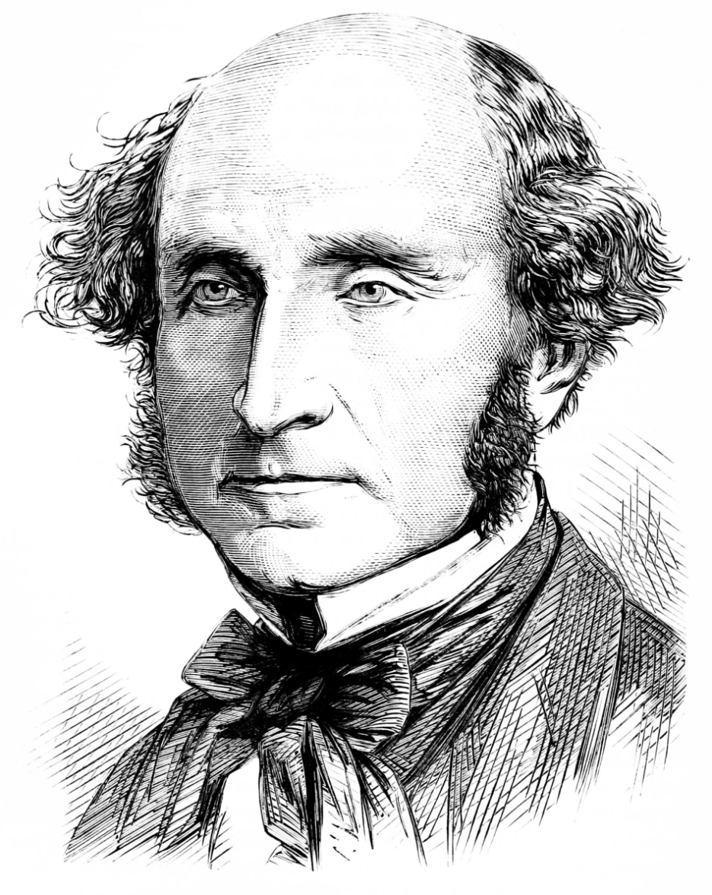
Bleak
A state that dwarfs its people, even for beneficial purposes, will soon find that with small people no great thing can really be accomplished.

Slide 8


Slide 9
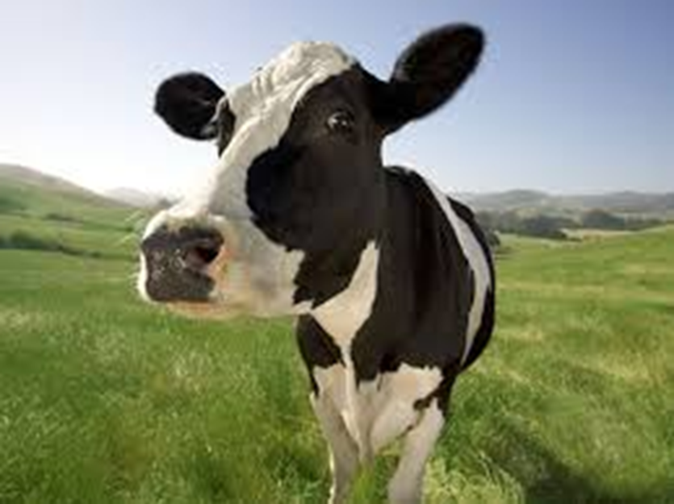
Convention
Competence
Compliance
Conformity

Slide 10
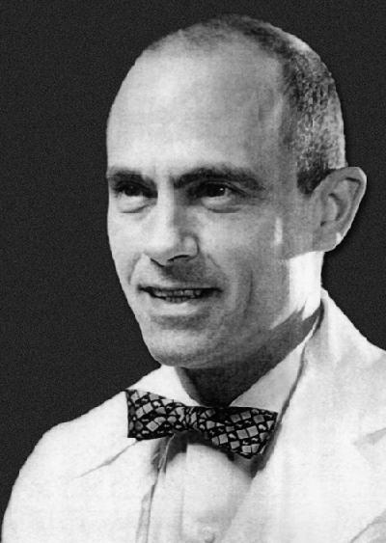
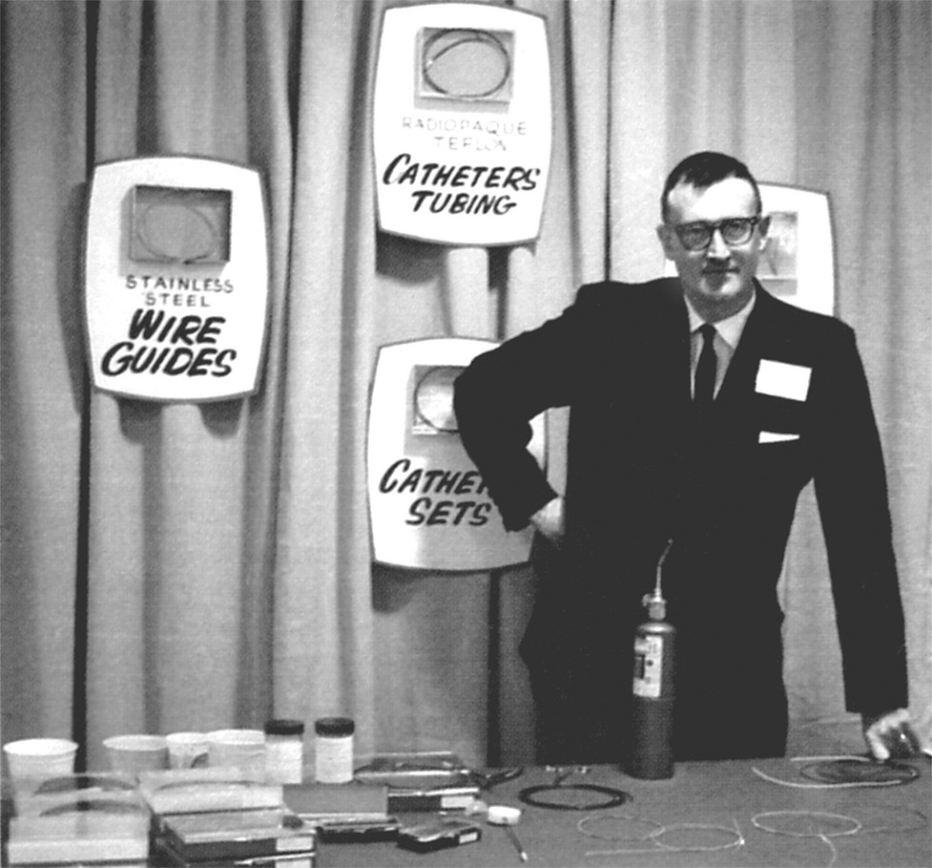
Cook on Convention
Convention

Slide 11
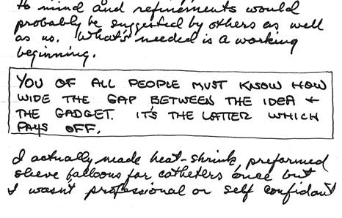
Cook on Convention
Ideas coming from physicians on front lines
Immediately build things no one ever thought of before

Slide 12

Commission Errors
Don’t
  Do something wrongly
Attempt
  Little
  Nothing

Slide 13
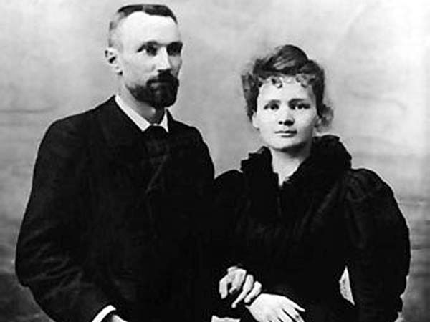
Commission Errors
Don’t
  Fail to do something
    Bold
    That matters

Slide 14
Cook on Commission
Bill Cook was willing to risk everything if he believed in what you were doing.
Guitar strings
VW speedometer cable
Vinyl insulation stripped from telecom cable found in waste-basket

Slide 15
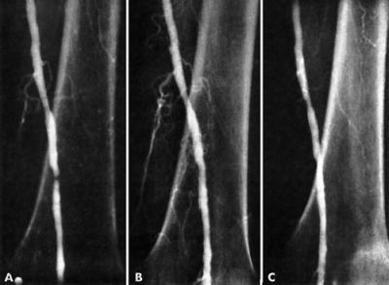
Cook on Commission
Bill Cook worked every day to do something new, something fun. He never really looked at the balance sheets.

Slide 16
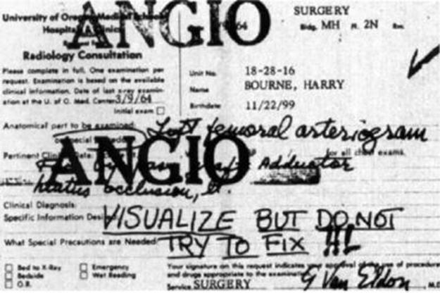
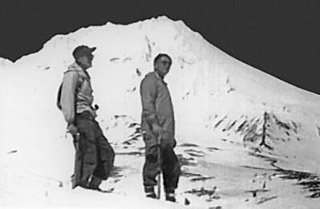
Cook on Commission
He would say, “Try this.” It often didn’t work, but the idea was to get us busy and into the problem. You couldn’t come back and say “That didn’t work.” He wanted you do come back with ideas of your own.

Slide 17
Cook on Commission
Suddenly there is the Life Magazine article showing products we had made in that 2-bedroom apartment.
Holy cow, we are making a difference here.

Slide 18
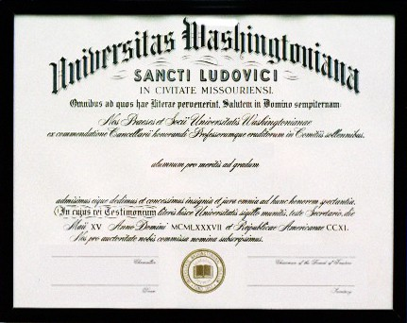
Credentials
MD
PhD
MBA

Slide 19
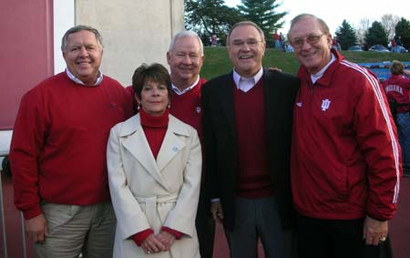
Cook on Credentials
Degrees
Curriculum Vitae
Professional experience

Slide 20
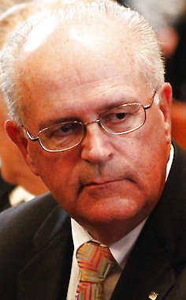
Cook on Credentials
Hire people who latched on to their jobs, took responsibility, cared about the quality of what they did

Slide 21



Control
Power over
Power to

Slide 22
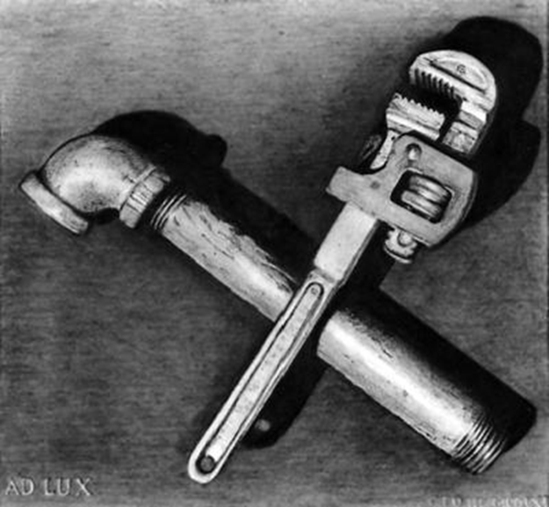
Control
Subordinates
  Education
  Experience
  Wisdom

Slide 23
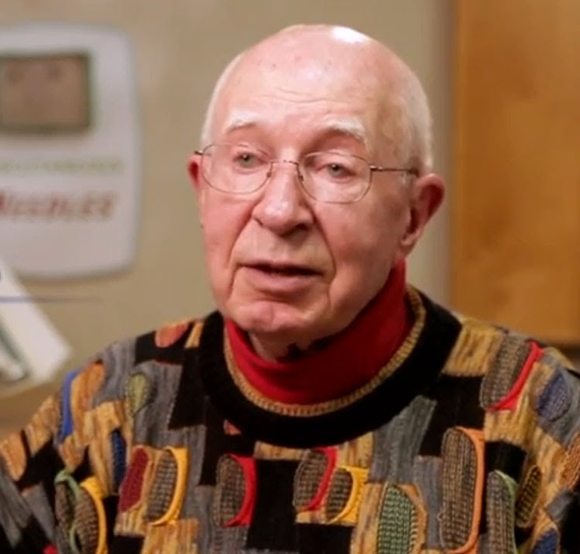
Cook on Control
“You know how I feel about organizations in Bloomington.” From then on, he never questioned anything I did.

Slide 24
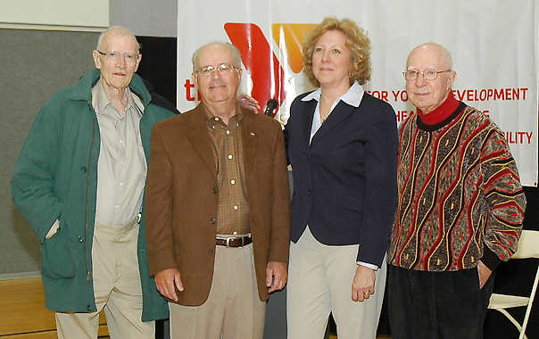
Cook on Control
He did not look over people’s shoulders, because what needed to be done had been embedded in them.

Slide 25
Cook on Control
Had to work smarter than others
Avoid bureaucracy
No budget

Slide 26

Confinement
Productivity
  Grades
  Test scores
  Throughput
  RVUs
  $$$

Slide 27
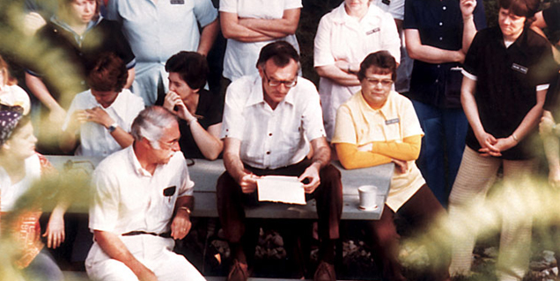
Cook on Confinement
Walking around
Dining room

Slide 28
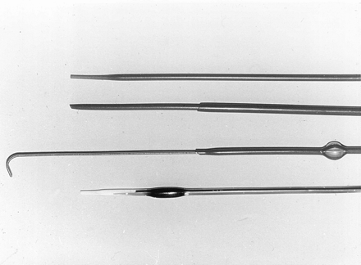
Cook on Confinement
Get out into field
Meet doctors
Listen to them
Build relationships with them
Make their ideas reality

Slide 29
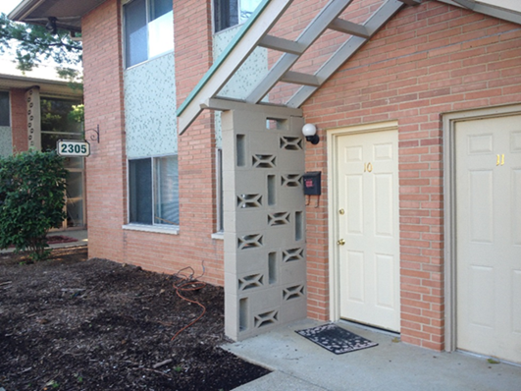
Confinement
Locus of knowledge
  Board room
  C-suite
  Front lines
Conflict of interest

Slide 30
Future of Physician Innovator
Convention
Commission errors
Credentials
Control
Confinement

Slide 31
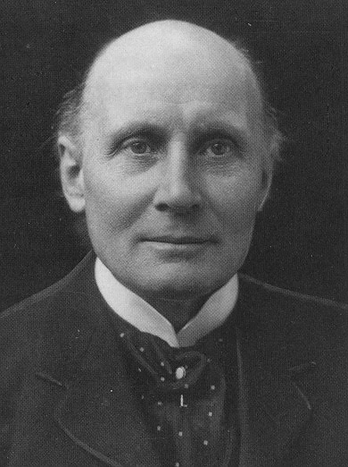
Crossroads
You are in a situation here much like that of the Mediterranean world, centering on the Aegean, say, between 1000 and 100 A.D. There was remarkable ease of water transportation, assisted by a lot of convenient islands; it prompted the movement of ideas and the mixing of gifted races. A “pure” race is likely to be stupid – the Lacedaemonians – but mix the native Attic stock with the Dorian invaders or the Ionians with the Asiatics, and the results are brilliant. You see, I am looking for your American equivalent of the Aegean, and I believe it is the Midwest.

Slide 32
Panel Discussion
Sheryl Conley,
President & Chief Executive Officer,
OrthoWorx
Bruce Gingles,
Vice President,
Global Techonolgy Assessment
& Healthcare Policy,
COOK Medical, Inc.
Alexander M. Djuricich, MD, FACP, FAAP
Associate Professor of Clinical Medicine & Clinical Pediatrics,
Indiana University School of Medicine
Jeff Hanthorn,
Chief Operating Officer,
NICO Corporation

Slide 33
Start-up Success Factors:
An Orthopedic/Medical Device Accelerator
Capable Entrepreneurs
Idea w/ Commercial Potential
Access to Customers End Users
Capital
Facilities
Expertise/ Advice
Suppliers
Exit Plan /Contacts at Strategics
Clinical Research Network
Academic Resources
Investigating a technology-focused, multi-staged Accelerator to provide these key elements to improve the chances for start-up success.

Slide 34
Panel Discussion
Sheryl Conley,
President & Chief Executive Officer,
OrthoWorx
Bruce Gingles,
Vice President,
Global Techonolgy Assessment & Healthcare Policy,
COOK Medical, Inc.
Alexander M. Djuricich, MD, FACP, FAAP
Associate Professor of Clinical Medicine & Clinical Pediatrics,
Indiana University School of Medicine
Jeff Hanthorn,
Chief Operating Officer,
NICO Corporation

Slide 35
Question & Answer

Slide 36
Future of the Physician Innovator
February 18, 2015

